Slide 1


Electric Vehicle Gap Analysis
Unnati Gaglani
Xue Han Han Yang
Ruoxuan Sang David Kim

Slide 2

Table of Contents
Team Introduction
Background
Executive Summary
Project Strategy
Solutions
Future steps
Conclusion
Reflection

Slide 3






Team Easy Ev
Unnati Gaglani
Han Yang
Jessica Sang
Xue Han
David Kim

Slide 4





Background
1.5 million customers in WA
Focus on safe, reliable, affordable energy service.
6,000 square miles service area in west Washington
Graham Marmion Data Scientist Focused on economic modeling and Transportation Electrification plan development.
Dr. Divya Chaudhary Assistant Teaching Professor Cloud computing Load scheduling Machine learning Systems and networking
Austin Escalera, M. Ed.
Graduate Student Services Coordinator, Career Coach

Slide 5
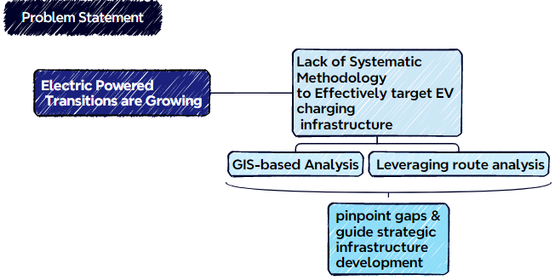
Problem Statement / Visualized Version

Slide 6
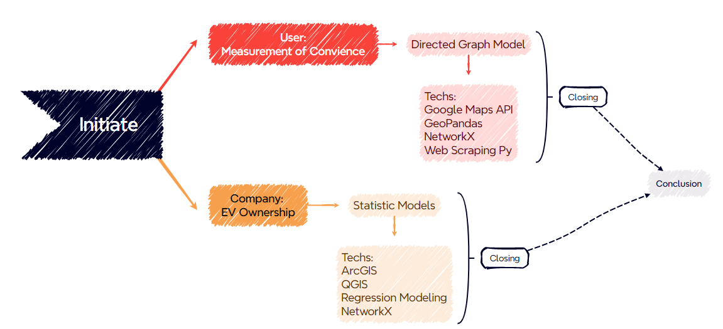
Strategy-Overview

Slide 7
Strategy- Agenda
Data Collection
Data Preprocessing
Modeling
Conclusion & Presentation

Slide 8
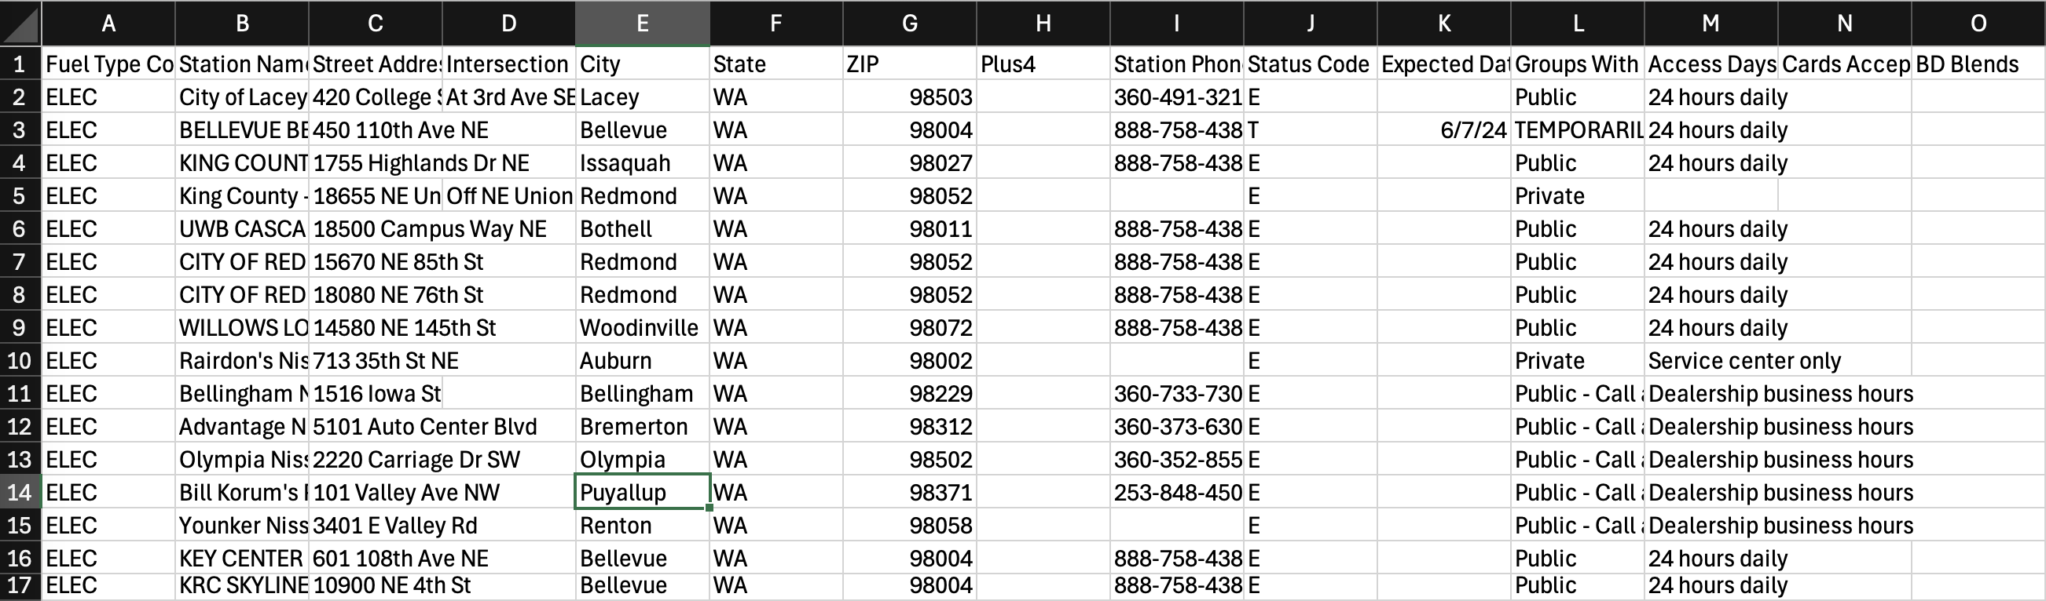
Data Overview – US Department of Energy
Contains information about the address, access days, longitude, latitude, number of ports, etc. for EV charging stations nationwide
Filtered to only include those in PSE service regions in WA state

Slide 9
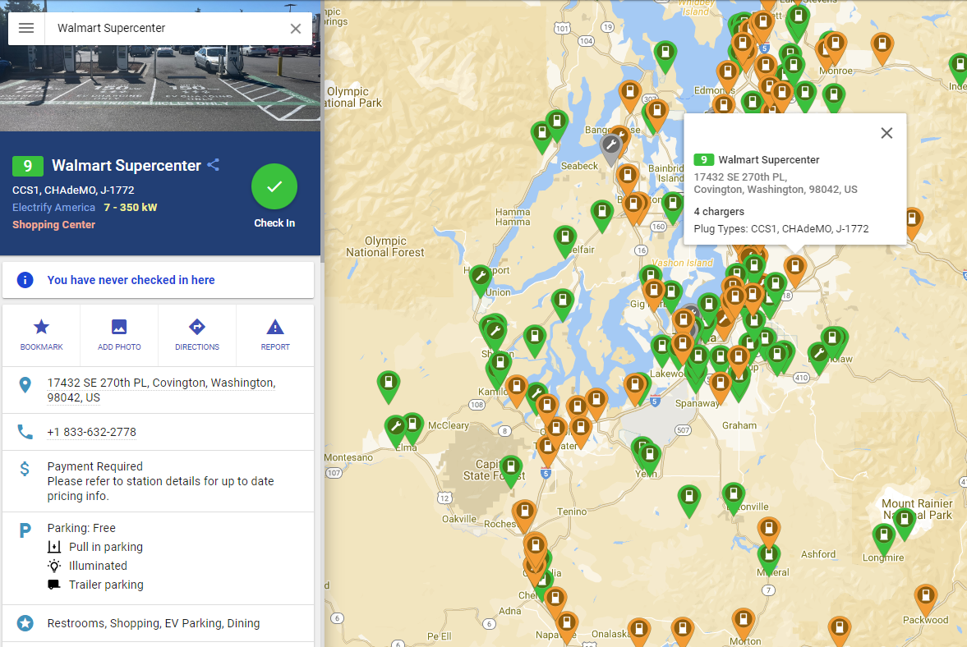
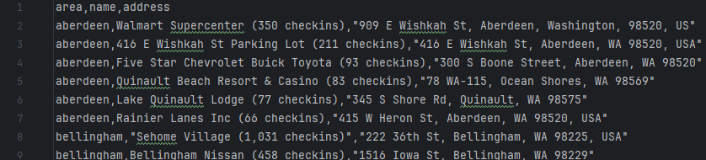
Data Overview - PlugShare
PlugShare.com provides a comprehensive map and database of electric vehicle charging stations, offering detailed information on locations, user reviews, and real-time availability.

Slide 10
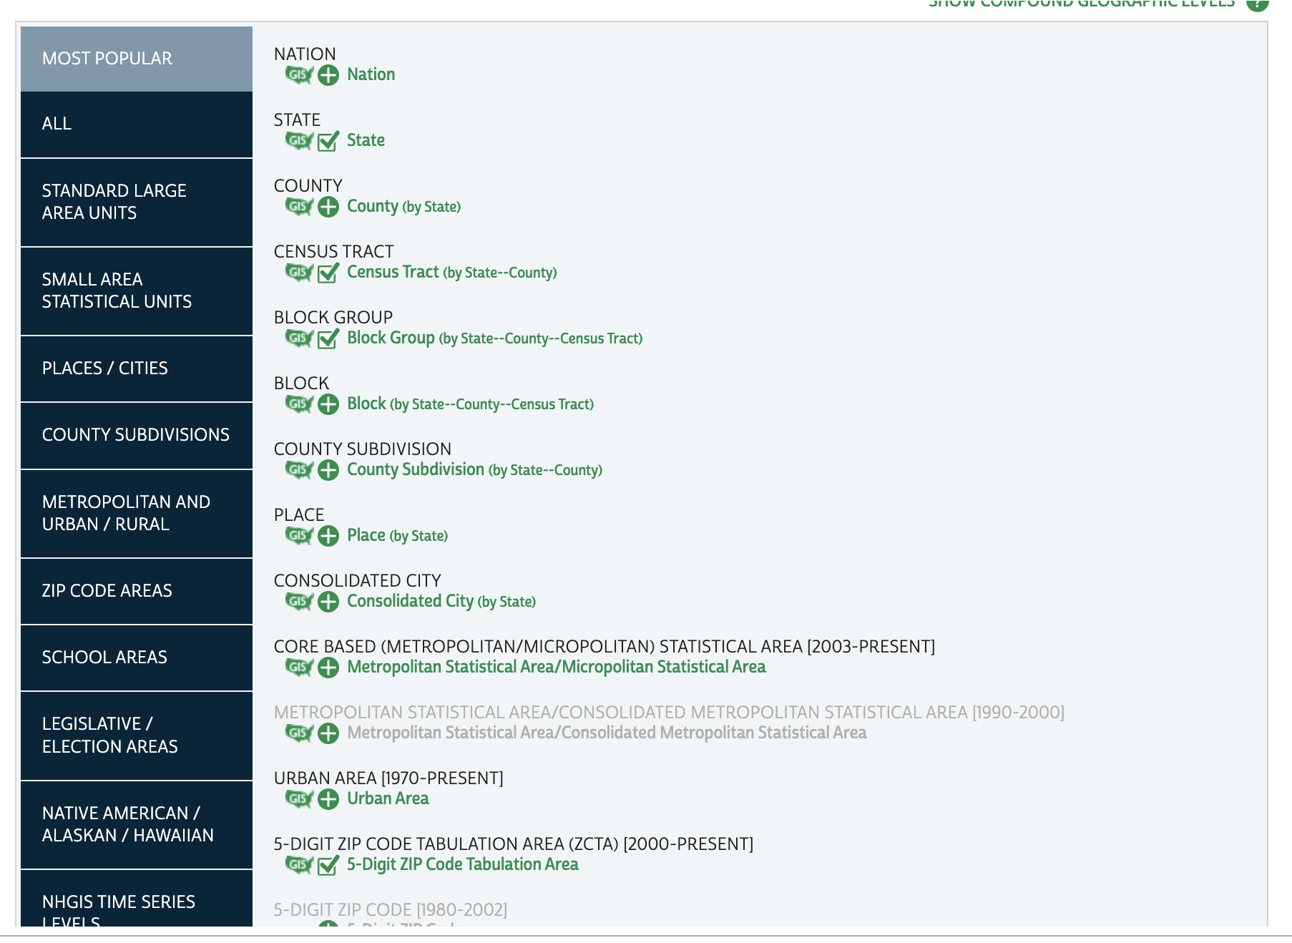
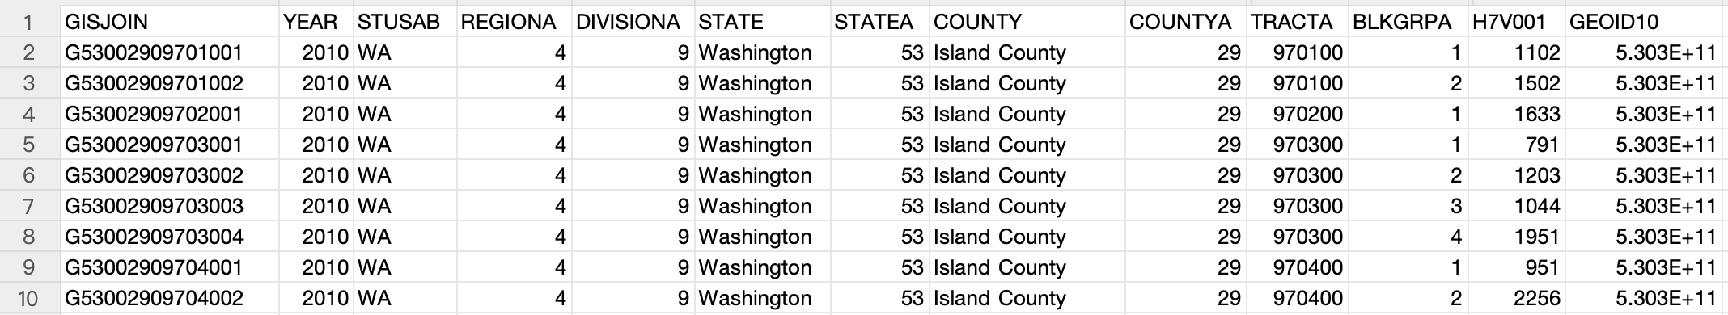
Data Overview - NHGIS
NHGIS provides extensive demographic data. By applying filters, we can access information like total population counts, population density, and the number of households, along with insights into population trends using 2010 data.

Slide 11
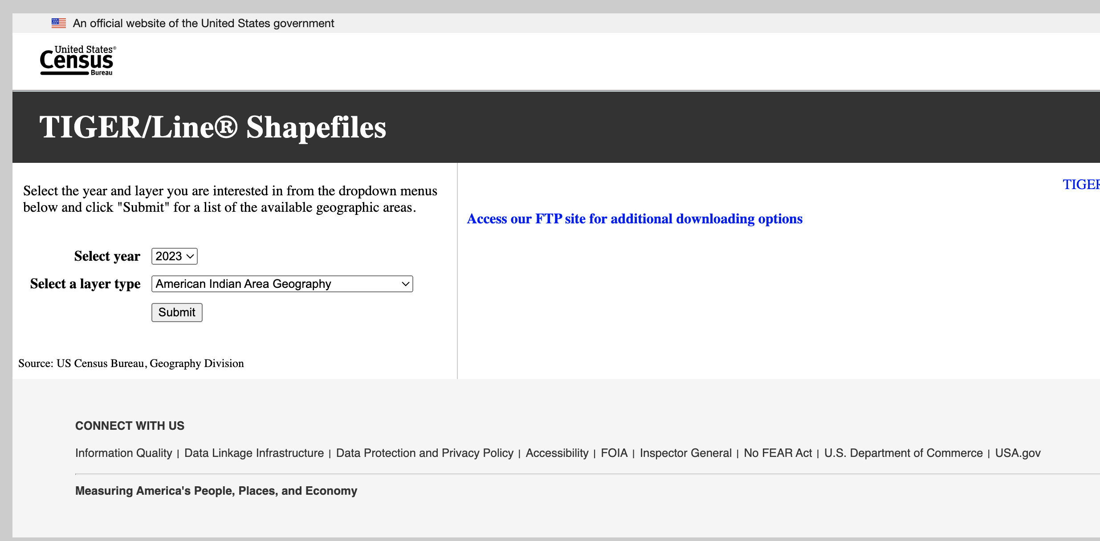
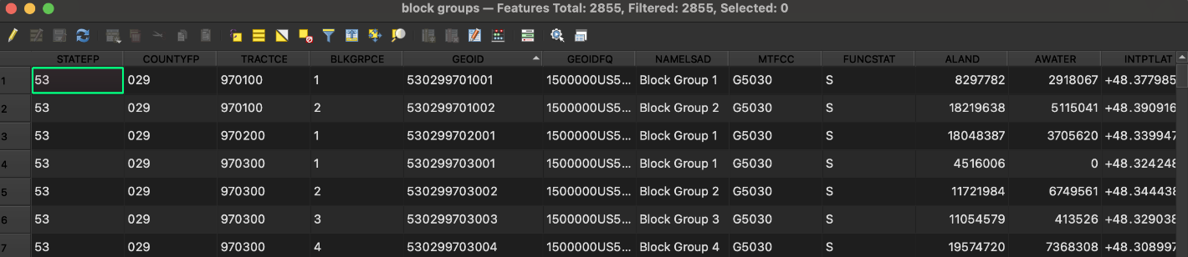
Data Overview – US Census
US Census for demographic and geographical data

Slide 12
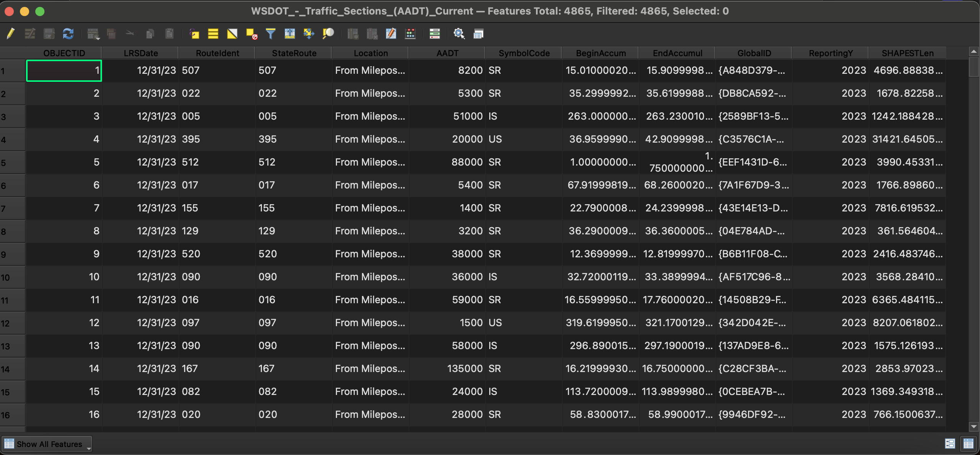
Data Overview – Average Annual Daily Traffic
AADT, or Average Annual Daily Traffic, is a measure of the average number of vehicles that pass a specific point on a road each day over the course of a year.

Slide 13

Solutions
Potential solutions:
Prioritize new charging stations in high-density urban areas to meet immediate demand.
Focus on high-traffic areas with low existing station density, emphasizing underserved regions with high Average Annual Daily Traffic (AADT).

Slide 14
Solutions
Reason for choosing the option to address the problem
Immediate high demand justifies rapid deployment.
Aligns infrastructure with high user demand, enhancing convenience and boosting EV adoption.

Slide 15
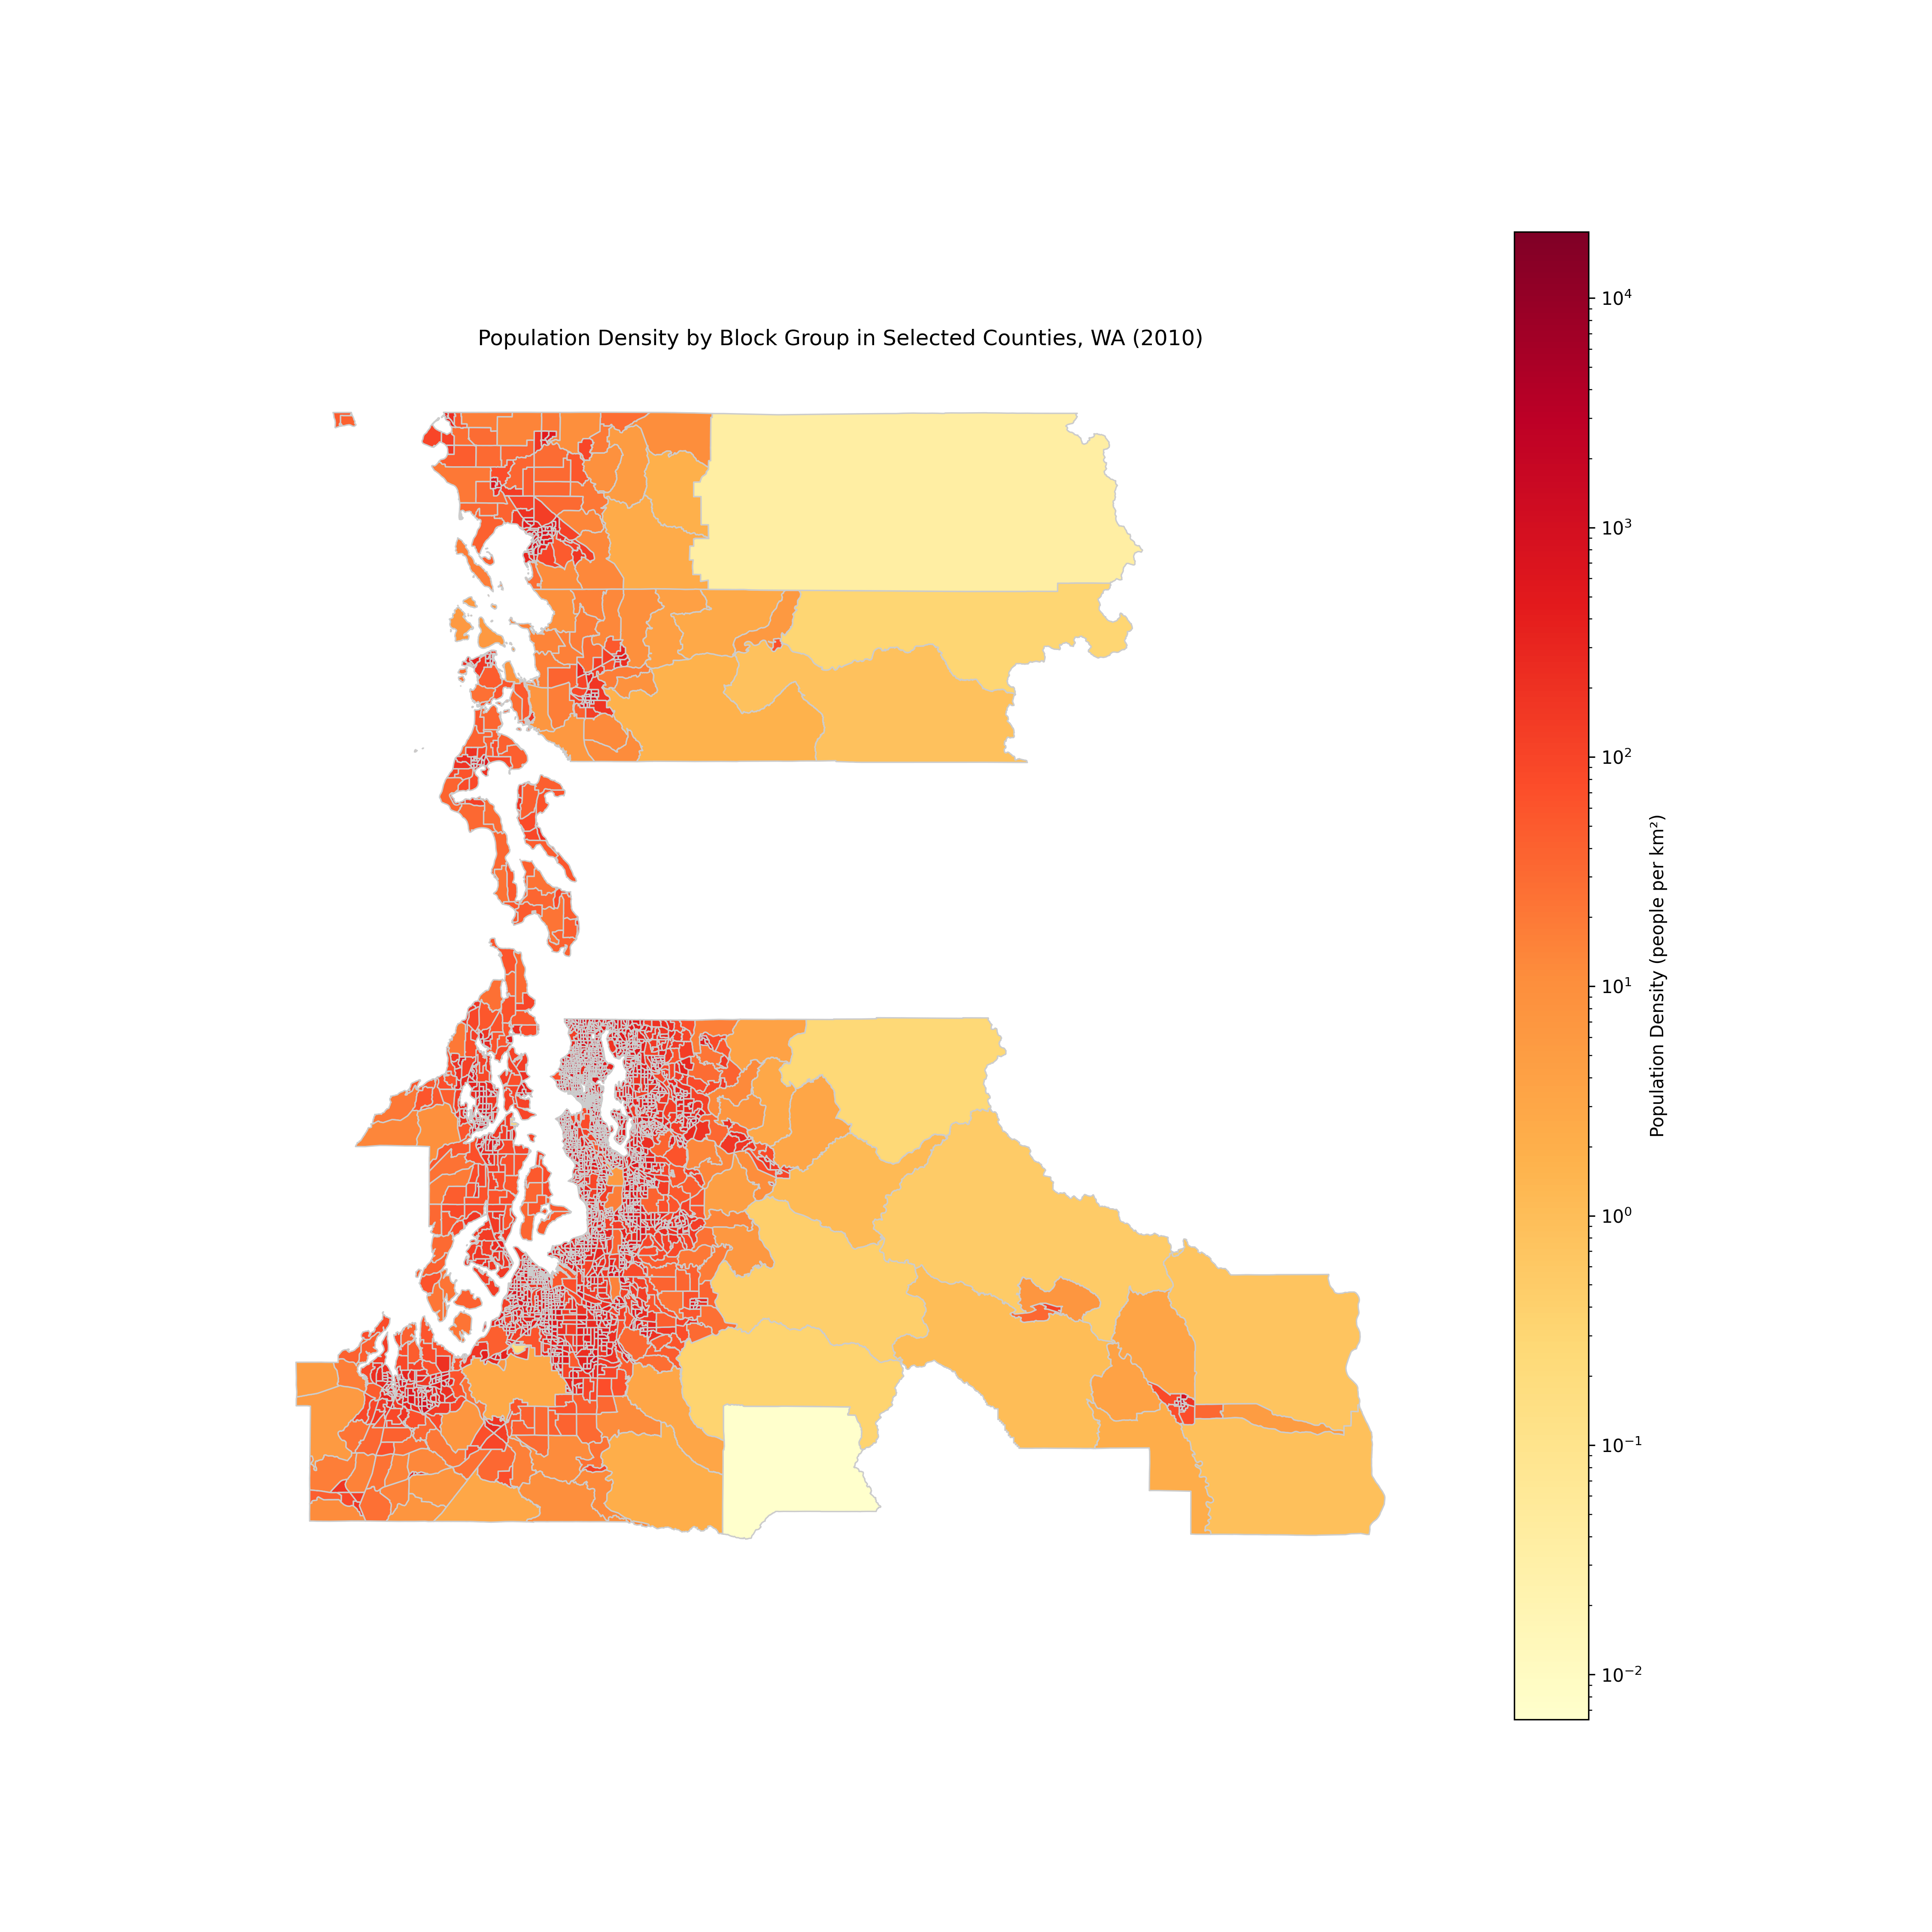
Solutions
Data and insights: Population Density Map
Highlights areas of high population density, indicating regions with immediate demand for charging infrastructure.

Slide 16
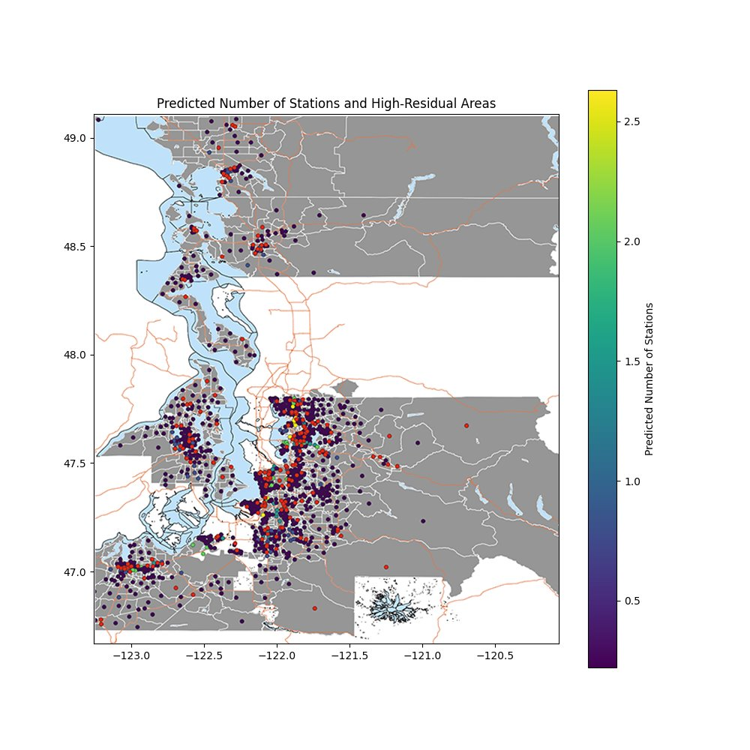
Solutions
Data and insights: Predicted Station Needs
Predicted station locations and areas with the highest unmet demand, guiding infrastructure placement.
Red Points: Areas where actual installations are below predictions, indicating potential priorities for future infrastructure development.

Slide 17
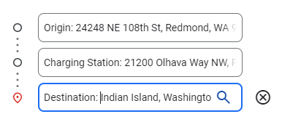
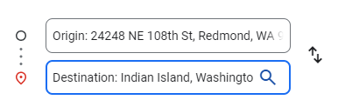
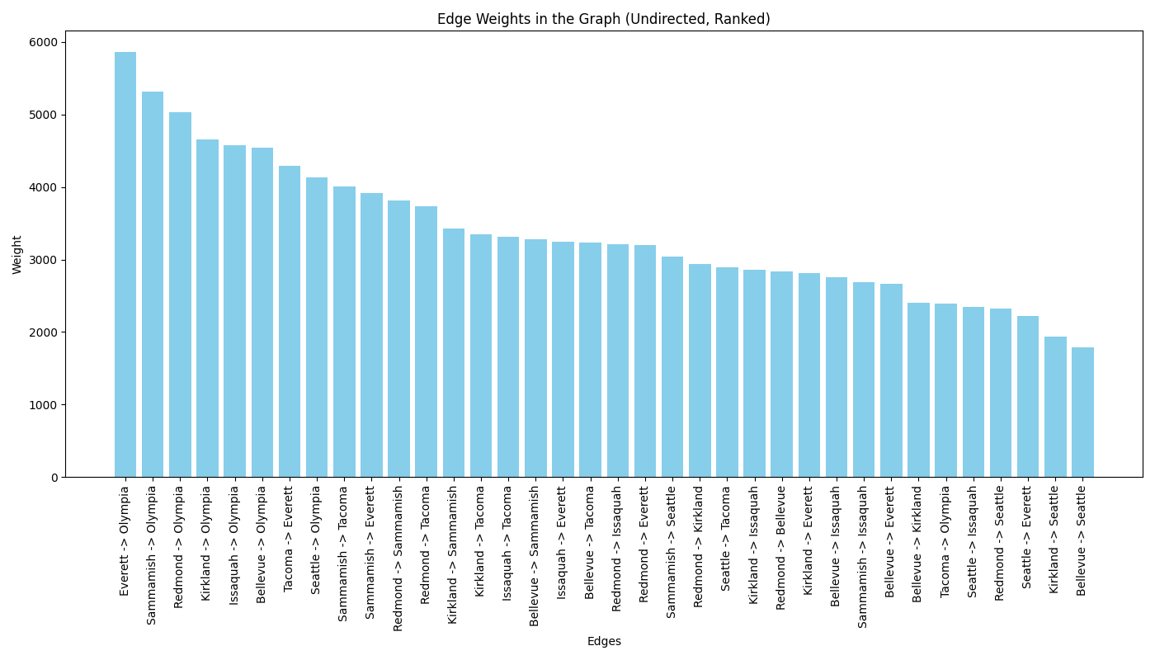
Solutions VS
Data and insights: Deviation Time Analysis

Slide 18
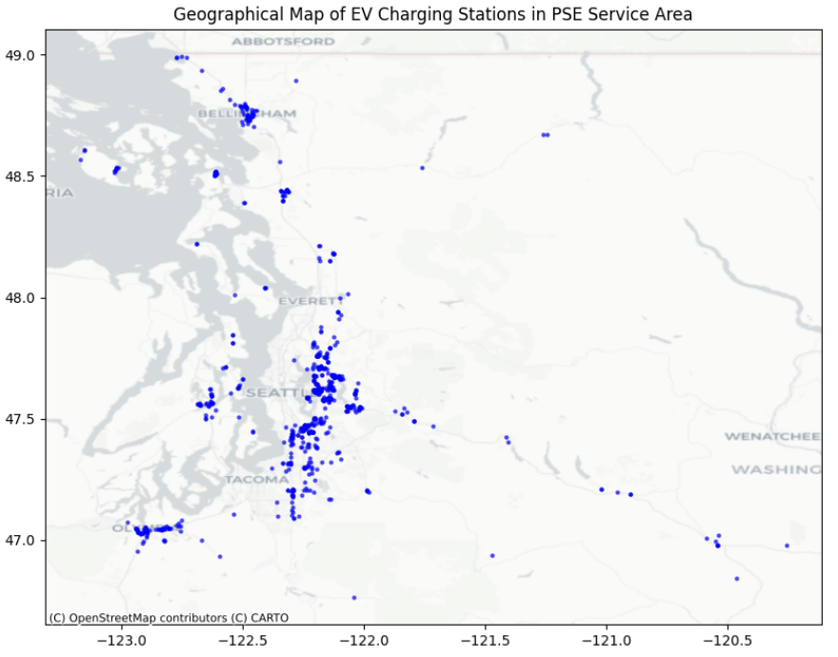
Solutions
Data and insights: PSE EV Locations
Current EV charging locations in the PSE service regions.

Slide 19

Next Steps
Competitor
Home/private chargers
Common routes and destinations

Slide 20

Conclusions
Urban Areas: High-density urban regions show effective EV charging coverage, correlating with high AADT levels.
Rural & Suburban Areas: Significant infrastructure gaps exist in rural and emerging suburban areas with lower traffic volumes.
Key Routes: Identified critical routes where additional EV stations could reduce travel time and support EV adoption.
Strategic Focus & Application: Targeted infrastructure enhancement in underserved areas should guide future planning to ensure a balanced and accessible charging network, supporting broader EV adoption.

Slide 21

Reflections
What Worked:
Effective GIS spatial analysis
Accurate identification of infrastructure gaps
Challenges:
Difficulties in integrating varied data sources
Challenges in accurate future growth predictions
Improvements for Future Projects:
Data Integration: Employ advanced techniques for smoother analysis.
Stakeholder Engagement: Involve stakeholders earlier for better insights and support.
Key Learnings:
Enhanced skills in spatial data analysis and visualization.
Gained experience in managing complex, data-intensive projects.
Recognized the importance of early and effective stakeholder communication.

Slide 22
Thank You!
---- Team Easy EV

Slide 23

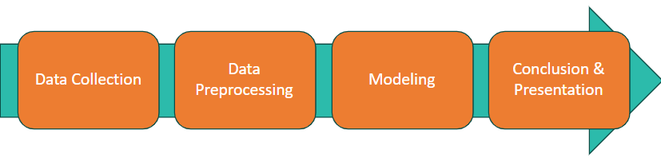






Team Easy EV & Puget Sound Energy
Where to Put Electric Vehicle Charging? Stations?
Introduction
Electric Vehicle Gap Analysis includes identifying lack of infrastructure of EV chargers where it is high needed in Puget Sound Energy (PSE)'s service area.
Goal & Problem Statement The project should identify the areas in PSE's electric service area with inadequate access to charging infrastructure. The ideal deliverable would be a geodatabase containing the data and conclusion regarding the gaps' in EV infrastructure as well as a summary slide deck giving an overview of the methodology and outputs.
Methodology
Next Steps
Home/private chargers
Common routes and destinations
Competitor
Data Overview
Techs: Cool Things We Did
Web Scraping For Data Integration
Python Panda for Data Cleaning
Google Geo API
Directed Graph Modeling
ArcGIS, QGIS Layer Construction
Geo Spatial Regression Model
Conclusion
Urban Areas: High traffic urban regions have good EV charging coverage.
Rural & Suburban Areas: Significant gaps in charging infrastructure.
Key Routes: Critical routes identified for additional stations to reduce travel time.
Strategic Focus: Focus on underserved areas to ensure a balanced, accessible charging network.
Solutions
Prioritize new charging stations in high-density urban areas to meet immediate demand. Focus on high-traffic areas with low existing station density, emphasizing underserved regions with high AADT.
References
US Census: https://www.census.gov/
NHGIS: https://www.nhgis.org/
PlugShare: https://www.plugshare.com/
US Department of Energy: https://www.energy.gov/

